Slide 1
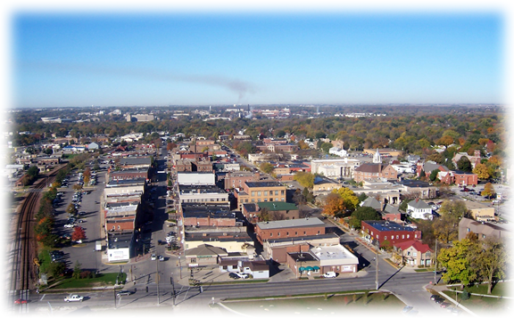
Ames, Iowa
Predicting Home Sale Prices
Michelle Cheung
March 22, 2018

Slide 2

Source of Data

Slide 3
Data Cleaning
NaN Cells
Data Types
Quantitative (0)
Qualitative (Unknown)
Central Limit Theorem (Pool QC)
Handled through later transformation
Initial Check
.shape
.info
.describe
‘SalePrice’ histogram

Slide 4
Feature Engineering
QUANtitative
QUALitative
Histograms
Interactions
Ruled Out Least Effective Features
House Age (subtraction)
Total Finished Square Foot (addition)
Garage Size (multiplication)
Overall Grade (addition)
Dummy Date Features
Year Built
Year Remod/Add
Garage Yr Blt
Mo Sold
Yr Sold
Correlation (Heat map)
Median Price Range (2*std)
Dummied these Features
Dropped Remaining Features

Slide 5
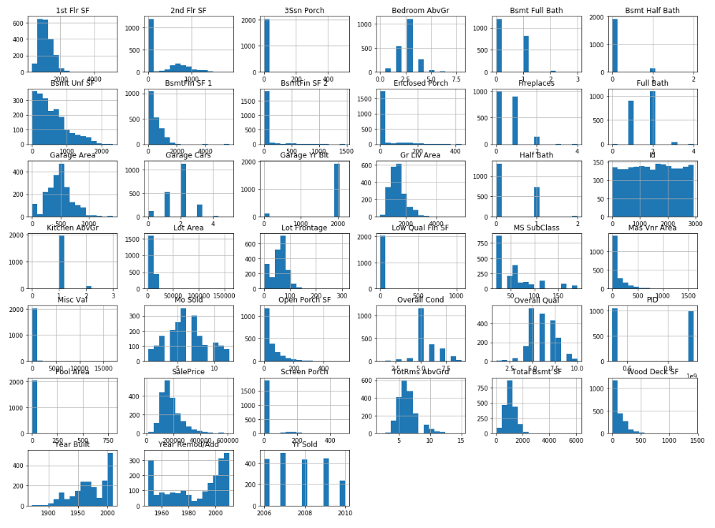
Feature Engineering (QUANtitative)

Slide 6
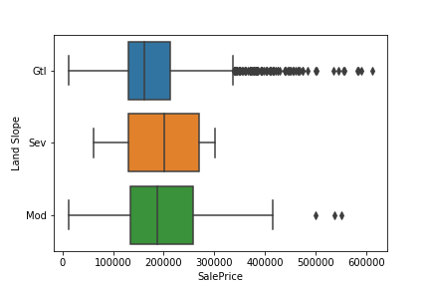
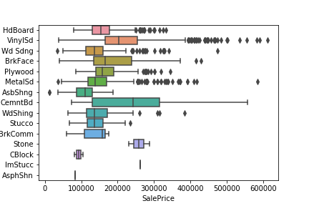
Feature Engineering (QUALitative)
Less Variance – Dropped
More Variance - Dummied

Slide 7
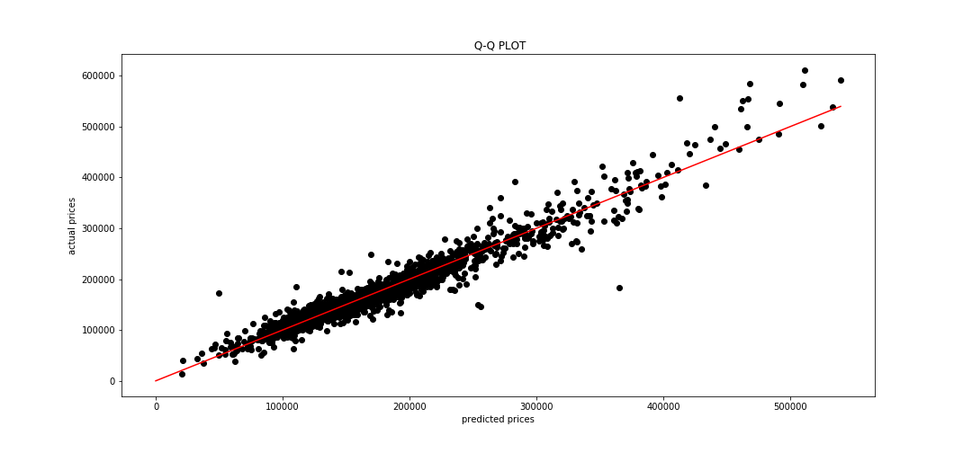
Q-Q Plot

Slide 8
Thank you!

